Slide 1
Product Mix Problem
What is product mix Problem?
The problem is to determine how much of each product should be produced, while minimizing the overall production cost, meeting the demand, and not exceeding the resource constraints.
What is the constraints of product mix?
  Product mix must usually adhere to the following constraints: Product mix can't use more resources than are available. There is a limited demand for each product. We can't produce more of a product during a month than demand dictates, because the excess production is wasted.

Slide 2
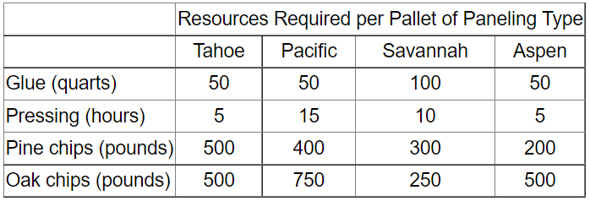
Product Mix Problem Example
Imagine that you manage a factory that produces four different types of wood paneling. Each type of paneling is made by gluing and pressing together a different mixture of pine and oak chips. The following table summarizes the required amount of gluing, pressing, and mixture of wood chips required to produce a pallet of 50 units of each type of paneling:

Slide 3
Product Mix Problem Example (cont.)
In the next production cycle, you have 5,800 quarts of glue; 730 hours of pressing capacity; 29,200 pounds of pine chips; and 60,500 pounds of oak chips available. Further assume that each pallet of Tahoe, Pacific, Savannah, and Aspen panels can be sold for profits of $450, $1,150, $800, and $400, respectively.
What would be your production strategy to maximize your profits?

Slide 4
Product Mix Problem Solution
Let’s assume that we will produce X1 for the number of Tahoe pallets, X2 for the number of Pacific pallets, and X3 for the number of Savannah pallets, and X4 for the number of Aspen pallets, the objective (calculating total profit) is:
Maximize: 450 X1 + 1150 X2 + 800 X3 + 400 X4
A pallet of each type of panel requires a certain amount of glue, pressing, pine chips, and oak chips. The amount of resources used (calculated by the left-hand side of each constraint) depends on the mix of products built, and we have a limited amount of each type of resource available (corresponding to the constraint right hand side values).

Slide 5
Product Mix Problem Solution (cont.)
The constraints for this problem are expressed as follows:
50 X1 + 50 X2 + 100 X3 + 50 X4 <= 5800 (Glue)
5 X1 + 15 X2 + 10 X3 + 5 X4 <= 730 (Pressing)
500 X1 + 400 X2 + 300 X3 + 200 X4 <= 29200 (Pine chips)
500 X1 + 750 X2 + 250 X3 + 500 X4 <= 60500 (Oak chips)
Since the number of products built cannot be negative, we'll also have non-negativity conditions on the variables:
X1, X2, X3, X4 >= 0

Slide 6
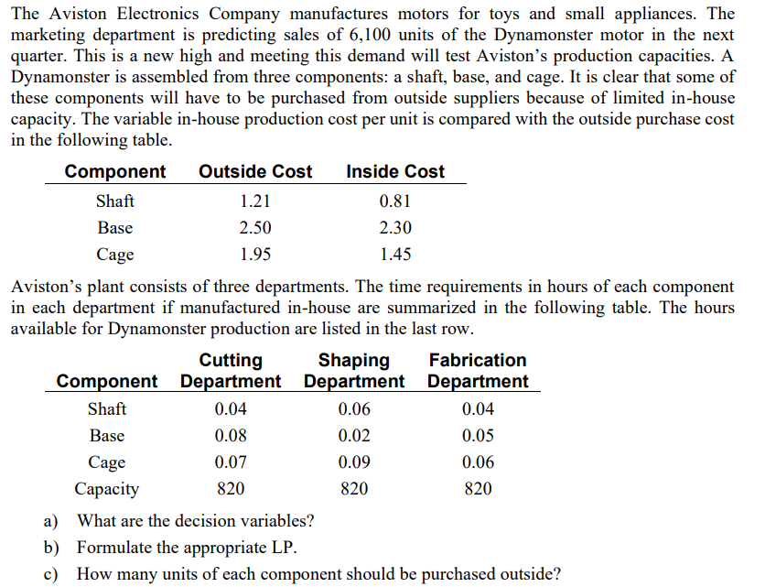
Homework Assignment

